Slide 1



||JAI SRI GURUDEV||
Sri Adichunchanagiri Shikshana Trust®
SJC INSTITUTE OF TECHNOLOGY
An Autonomous Institution under VTU from 2024-25
AICTE Approved, Accredited by NBA (CSE, ISE, ECE, ME, CV, AE) &NAAC
with A+ grade, Gold rated by QS I-Gauge B. B. Road, Chikkaballapura, Karnataka, India-562101
ARTIFICIAL INTELLIGENCE
PRESENTATION
on
“BOOK RECOMMENDATION
CHATBOT”
Submitted By:
Rakshitha S M
S Tejashwini
Shreya B R
Sreeraksha H S
Under the guidance of:
Prof. Mala
Assistant Professor
SJCIT

Slide 2
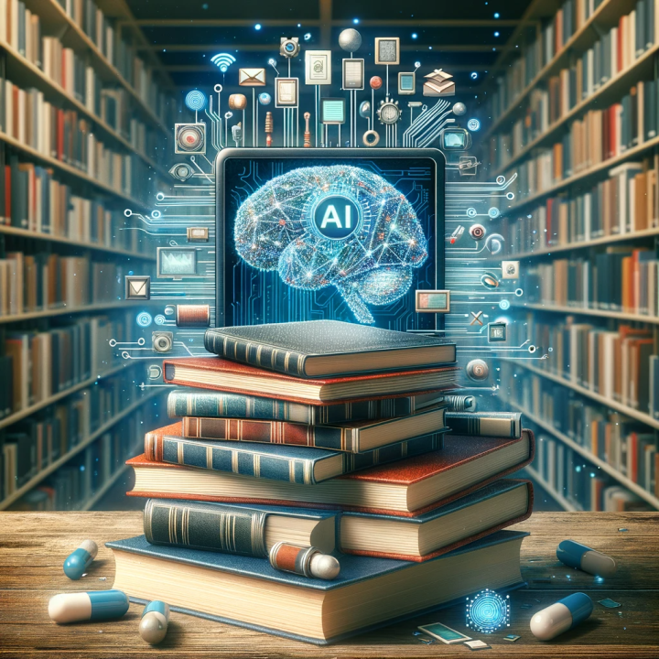
Introduction
Book recommendation chatbots are AI-driven tools designed to assist users in finding books tailored to their preferences.
They utilize algorithms to analyze user input and suggest relevant titles from vast databases.
These chatbots enhance the reading experience by providing personalized recommendations that align with individual tastes.
Notes:
Image source: https://www.ceipal.com

Slide 3
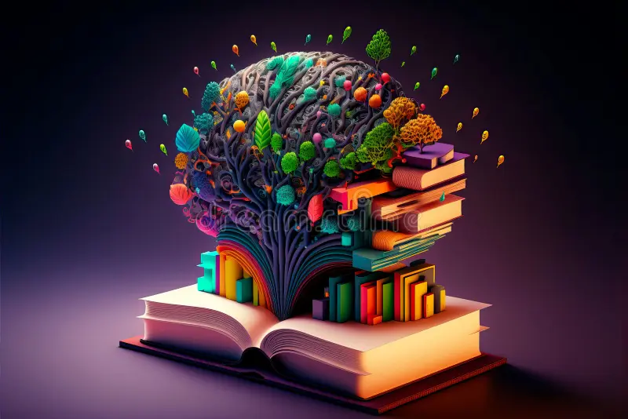
How Chatbots Function
Chatbots utilize natural language processing (NLP) to understand and respond to user inquiries.
They can engage in dialogue, asking clarifying questions to refine recommendations further.
Data mining techniques help them learn from user interactions, improving future recommendations.
Notes:
Image source: https://www.slidemake.com

Slide 4

Benefits of Using Book Recommendation Chatbots
They save time by quickly sifting through large volumes of books to find suitable options.
Users receive personalized suggestions that they might not discover on their own.
Chatbots can operate 24/7, providing book recommendations at any time convenient for the user.
Notes:
Image source: https://miro.medium.com

Slide 5
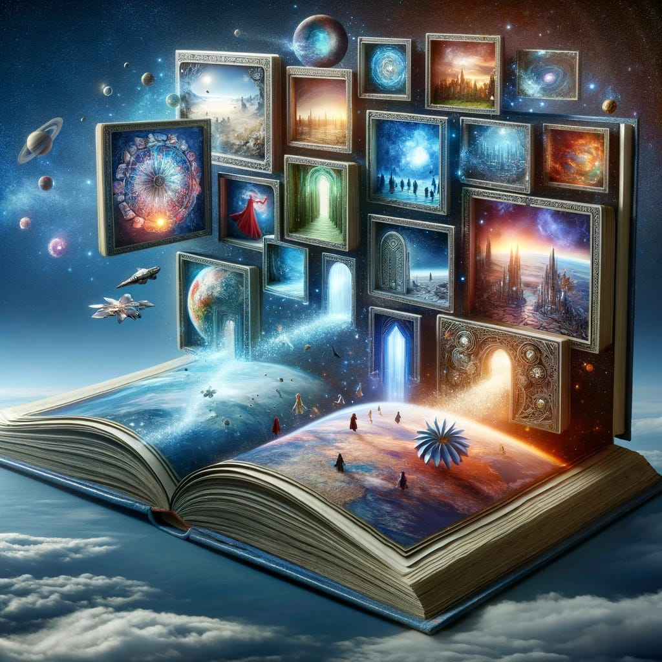
Popular Platforms for Book Recommendation Chatbots
Many online bookstores and libraries have integrated chatbots to enhance user experience.
Platforms like Goodreads and Amazon utilize recommendation algorithms in their services.
Standalone chatbots, such as ChatGPT, offer users a conversational way to discover new books.
Notes:
Image source: https://i.bpo.totalsoft.ro

Slide 6

Key Features of Effective Chatbots
An intuitive user interface is essential for seamless interactions and ease of use.
The ability to learn and adapt from user feedback ensures recommendations remain relevant.
Integration with various book databases enhances the breadth of recommendations available.
Notes:
Image source: https://slideai.net

Slide 7

User Interaction Examples
A user might ask the chatbot for fantasy recommendations based on their favorite authors.
The chatbot can suggest titles, provide brief summaries, and even link to purchase options.
Users can rate the suggestions, allowing the chatbot to refine its future recommendations.
Notes:
Image source: https://analyticsindiamag.com

Slide 8

Challenges Faced by Book Recommendation Chatbots
Understanding nuanced user preferences can be difficult for AI systems.
Maintaining an up-to-date database with new releases and trending titles is crucial for accuracy.
Ensuring user privacy and data security is a significant concern in chatbot development.
Notes:
Image source: https://miro.medium.com

Slide 9

Future Trends in Book Recommendation Chatbots
Advancements in AI and machine learning will lead to more sophisticated recommendation systems.
Increased personalization through user profiling will further enhance the user experience.
Integration with social media could allow for shared recommendations and community-driven insights.
Notes:
Image source: https://tmohentai.org

Slide 10

Case Studies of Successful Chatbots
Chatbots like "BookBot" have garnered positive user feedback for their engaging interactions.
Libraries utilizing chatbots have reported increased user engagement and circulation of recommended titles.
Successful implementations highlight the potential for chatbots to revolutionize book discovery.
Notes:
Image source: https://i.pinimg.com

Slide 11

Conclusion
Book recommendation chatbots symbolize the intersection of technology and literature.
They provide a valuable service, helping readers navigate the vast world of literature.
As AI technology advances, these chatbots will become even more integral to the reading experience.
Notes:
Image source: https://news.mit.edu

Slide 12

References
"The Impact of AI on Book Recommendations," Journal of Digital Libraries, 2023.
"Chatbots in E-commerce: A Study of User Interactions," International Journal of Human-Computer Studies, 2023.
"Understanding User Preferences in Book Recommendation Systems," Proceedings of the ACM Conference on Intelligent User Interfaces, 2023.

